Slide 1

Vel Tech Rangarajan Dr. Sagunthala R&D Institute of Science and Technology
School of Computing
Department of Computer Science and Engineering
10211CS224 / FULL STACK APPLICATION DEVELOPMENT (JAVA)
PROJECT REVIEW : MILESTONE PROJECT – 1
Date: 24-03-2026
END-TO-END EVENT LIFECYCLE & TICKETING PLATFORM
SDG: SDG 9 – INDUSTRY, INNOVATION AND INFRASTRUCTURE
Presented By:
J. MADHUMITH CHOWDARY – VTU25576 –23UECS0229
Courses Handling Faculty: Dr. Hafizur Rahman

Slide 2
INTRODUCTION
Web-based platform for managing the full event lifecycle
Allows organizers to create and manage events easily
Supports ticket booking and user registration
Tracks attendees efficiently in real time
Eliminates manual processes and reduces errors
Automates booking, registration, and event monitoring
Provides real-time updates for users and organizers
Ensures a smooth and seamless user experience
Useful for colleges, organizations, and event planners
Reduces workload and improves operational accuracy
Offers a complete digital solution for event management
1
2
3
4
5
6
7
8
9

Slide 3
PROBLEM STATEMENT
Event management processes are often manual or use disconnected systems
Leads to data inconsistency and errors
Causes issues like ticket duplication
Poor tracking of attendees
Users face difficulty in booking tickets efficiently
Organizers lack tools for event management and performance analysis
No centralized platform for handling the complete event lifecycle
Results in time wastage and operational inefficiencies
Creates a need for a reliable and automated system
The solution should ensure accuracy, security, and ease of use
1
2
3
4
5
6
7
8
9

Slide 4
OBJECTIVE(S)
To design and develop a complete event management and ticket booking system
To implement secure user authentication and real-time ticket processing
1
2
3
4
5
6
7
8
9

Slide 5
PROPOSED SYSTEM
Web-based platform for event creation and management
User registration and login system
Online ticket booking with confirmation
Admin dashboard to manage events and users
Secure database storage using SQL
Real-time availability of tickets
Automated booking and cancellation system
Easy-to-use interface for both users and admins
1
2
3
4
5
6
7
8
9

Slide 6
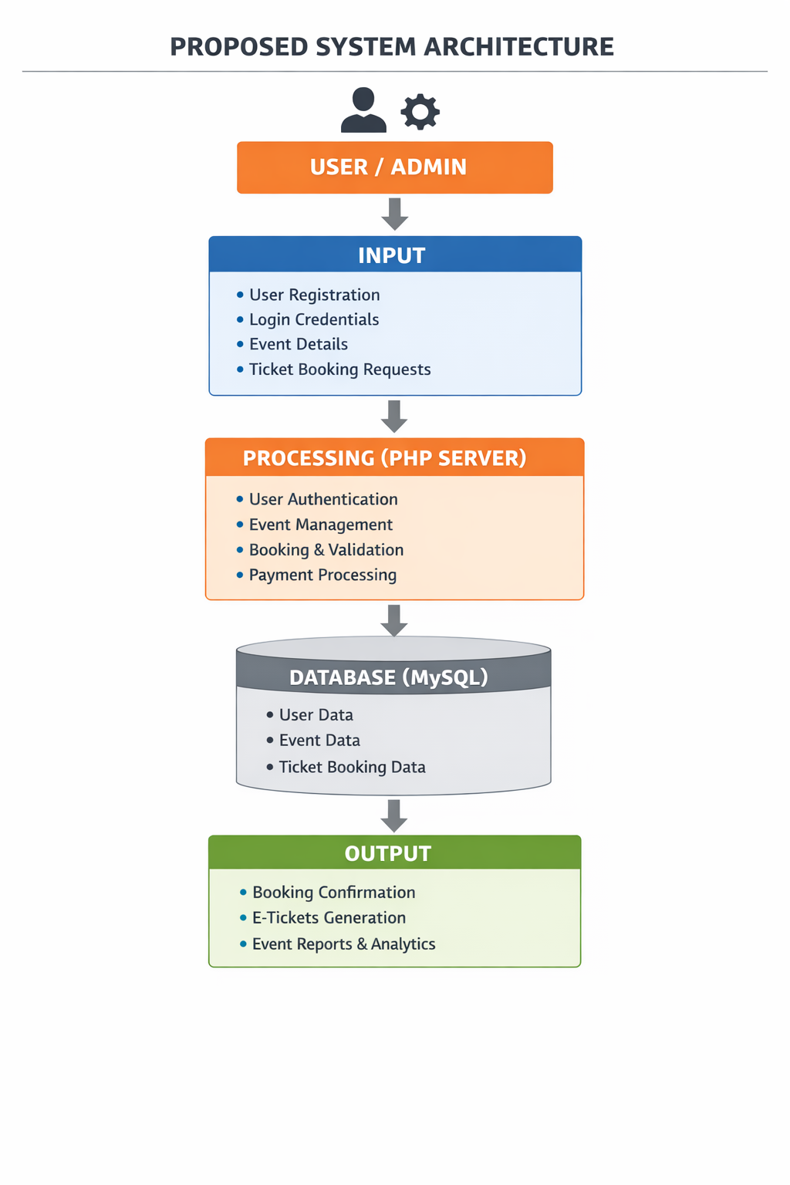
PROPOSED SYSTEM ARCHITECTURE
1
2
3
4
5
6
7
8
9

Slide 7
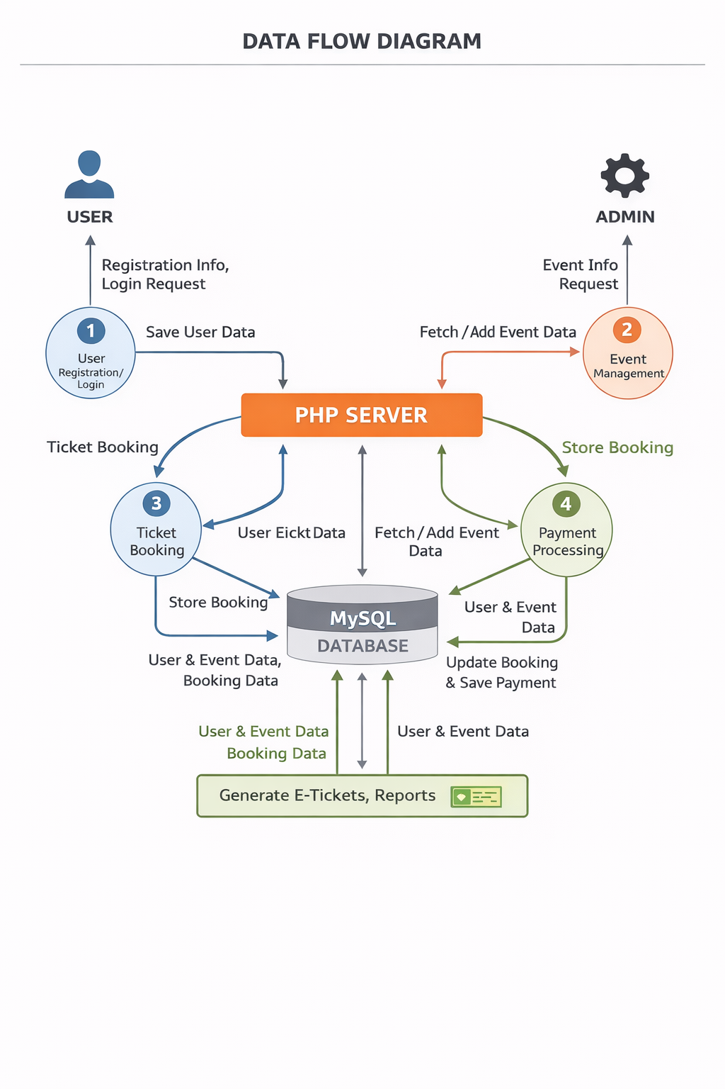
WORKFLOW
1
2
3
4
5
6
7
8
9

Slide 8
TECHNOLOGIES USED
TECHNOLOGIES USED
Frontend:
HTML, CSS, JavaScript
Backend:
PHP
Database:
MySQL
Tools:
XAMPP, phpMyAdmin, VS Code
Hardware/Software Requirements:
System with minimum 4GB RAM
Browser (Chrome/Edge)
Windows/Linux OS
1
2
3
4
5
6
7
8
9

Slide 9
MODULE DESCRIPTION
Module 1: User Management Handles user registration, login, and authentication.
Module 2: Event Management Allows admin to create, update, and delete events.
Module 3: Ticket Booking System Users can book, cancel, and view tickets.
Module 4: Database Management Stores user, event, and booking data securely.
Module 5: Admin Dashboard Provides analytics, reports, and full control over system.
1
2
3
4
5
6
7
8
9

Slide 10
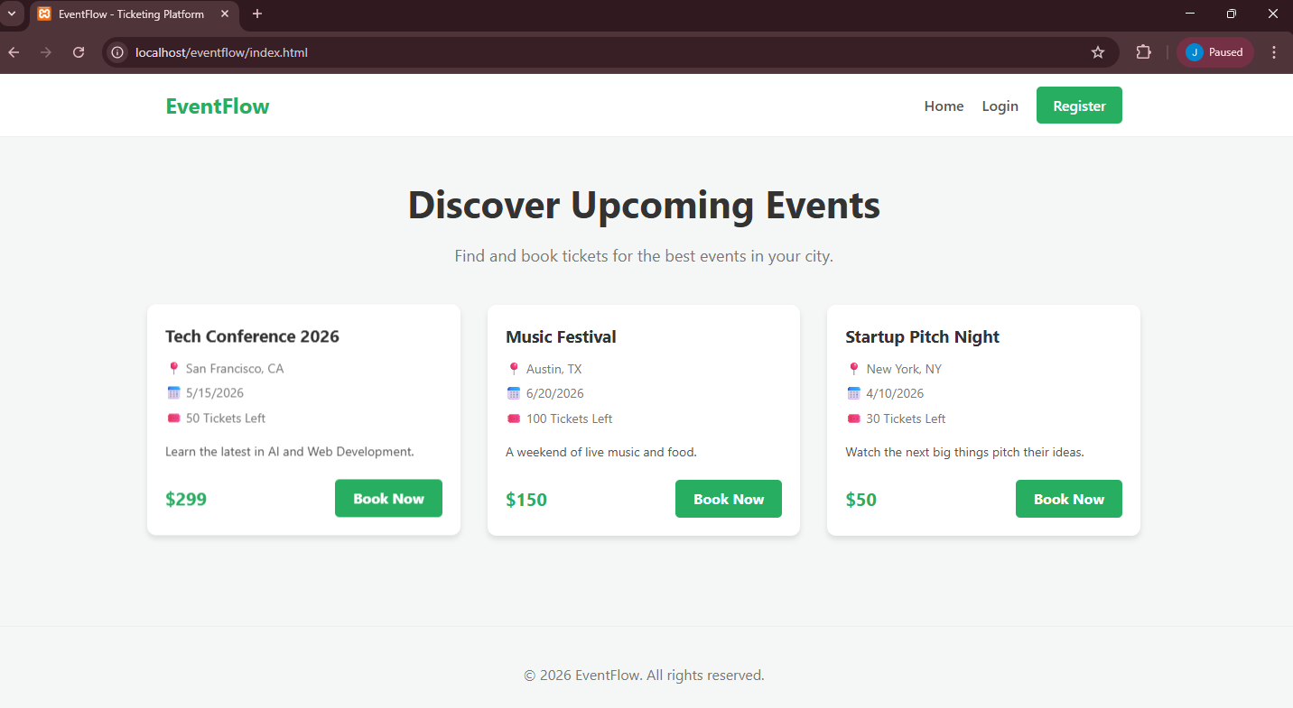
IMPLEMENTATION SCREENSHOTS
1
2
3
4
5
6
7
8
The home page of the EventFlow platform displays upcoming events with details like date, location, ticket availability, and pricing in a clean, user-friendly layout. It allows users to easily explore events and book tickets quickly using the “Book Now” option.
9

Slide 11
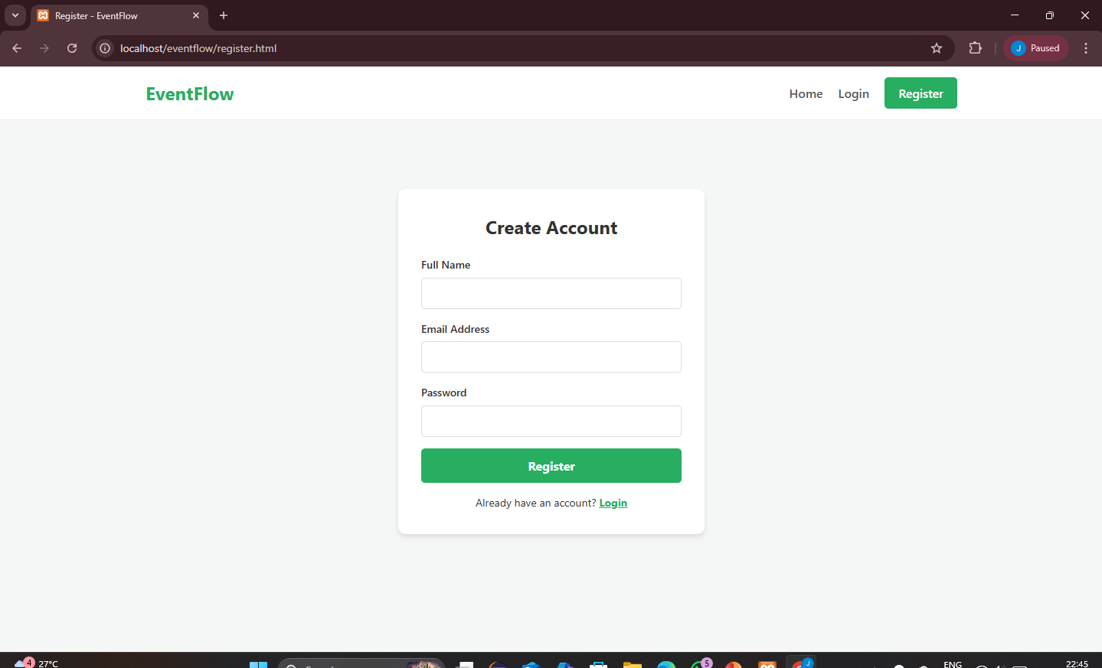
IMPLEMENTATION SCREENSHOTS
1
2
3
4
5
6
7
8(A)
The login/register page allows users to create a new account by entering basic details like name, email, and password. It provides secure access to the platform and enables users to book tickets and manage their activities.
9

Slide 12
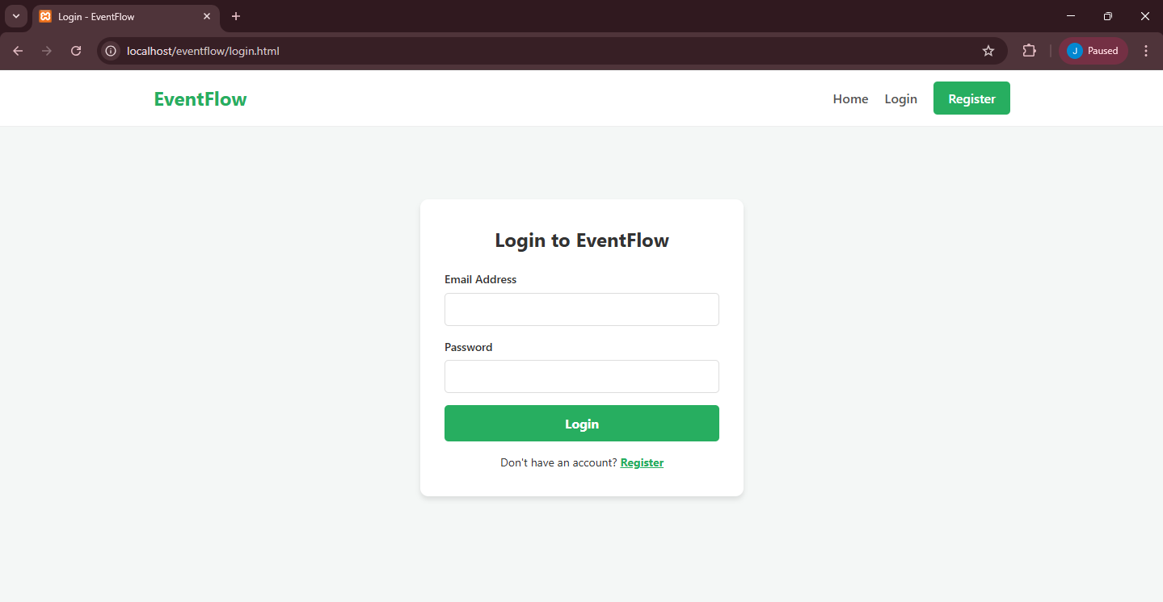
IMPLEMENTATION SCREENSHOTS
1
2
3
4
5
6
7
The login page allows existing users to securely access their accounts using email and password. It ensures authentication and provides access to event booking and user-specific features.
8(B)
9

Slide 13
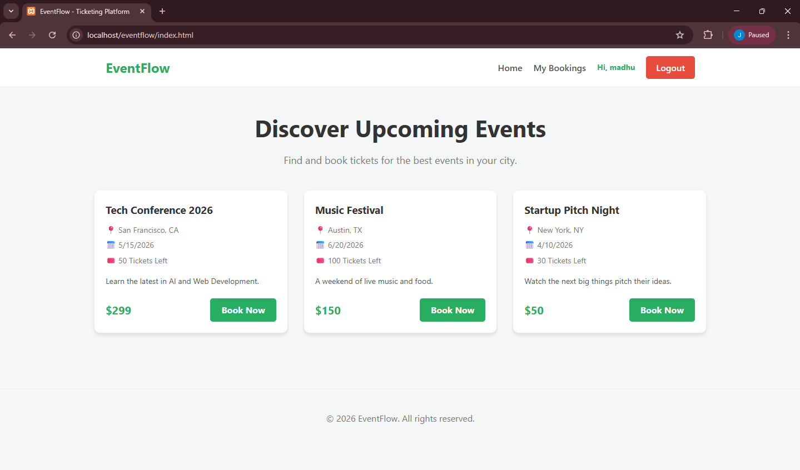
IMPLEMENTATION SCREENSHOTS
1
2
3
4
5
6
7
The user dashboard displays personalized options like “My Bookings” and logout along with available events. It allows logged-in users to easily browse events and book tickets with a customized experience.
8(C)
9

Slide 14
ADVANTAGES & LIMITATIONS
1
Advantages:
Easy to use and automated system
Reduces manual work
Secure and reliable
Real-time ticket booking
Limitations:
Requires internet connection
Basic UI (can be improved)
No payment gateway (if not implemented)
2
3
4
5
6
7
8
9

Slide 15
Thank you

